Slide 1
Capstone Tracker
Damon Black

Slide 2
Why?
It may be difficult
For a student to realize how much effort they are, or aren’t, putting into capstone
For a student to demonstrate their progress to their instructor
For an instructor to give a student advice if they aren’t sure where the student is

Slide 3
Goals
Assist both students and instructors with communication
Learn new technologies and expand knowledge of current technologies
Become a better frontend developer

Slide 4




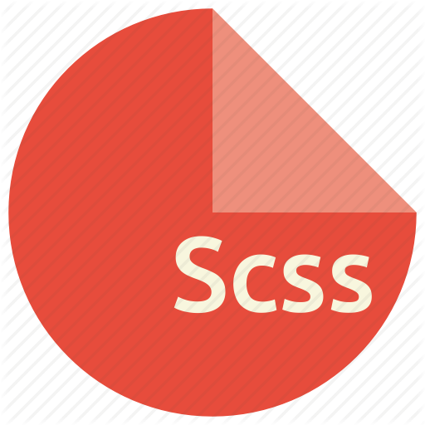




Technologies
Known
Unknown
SQL
C#
Postman
Visual Studio
Visual Studio Code
SSMS
JavaScript
React
Axios
Asp.Net Core
SCSS

Slide 5
Demo

Slide 6
What I learned
JavaScript
React
Better knowledge of Authorization and Authentication
Asp.Net Core Web API
Styling using SCSS

Slide 7
Moving forward
Implement AuthO and OAuth
Better practices with SCSS
More mobile friendly
Deployment
Not just capstone tracker
Trend Finding
Default scheduling for “Busy” hours
Etc.

